Slide 1
Lesson: Array

Slide 2
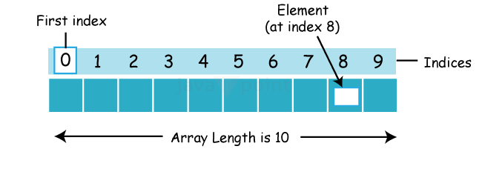
Array:
Arrays are collection of similar data type.
The value are stored based on index.
The index will start 0 to n-1.
Array will allow duplicate. If we don’t assign any value, it will take the default value of data type.
Array is static memory allocation
Syntax:
int num[] = new num[10];
Here,
Int→datatype
Num→variable
[]→Array
10→Array length
--It takes 0 to n-1; n=10;n-1=9;
Memory Allocation of Array

Slide 3
Types of an Array:
There are two types of array.
Single Dimensional Array
Multidimensional Array
Single Dimensional Array:
-A single-dimensional array in Java is a linear collection of elements of the same data type.
Syntax:
datatype[] refname=new datatype[size/length];
Multidimensional Array:
-A multidimensional array in Java is an array of arrays where each element can be an array itself. It is useful for storing data in row and column format.
Syntax:
int[][] arr=new int[3][3];//3 row and 3 column

Slide 4
For-each Loop for Java Array:
We can also print the Java array using for-each loop.
The Java for-each loop prints the array elements one by one.
It holds an array element in a variable, then executes the body of the loop.
The syntax of the for-each loop is given below:
for(datatype varname:declaredvarname){
//body of the loop
}
Normal loop | For each loop
Index based | Value based
we can compare | We can't compare
Normal | Efficient

Slide 5
Advantages and Disadvantages of an array:
Advantages of an Array:
Code Optimization: It makes the code optimized, we can retrieve or sort the data efficiently.
Random access: We can get any data located at an index position.
In a Single variable we can store multiple values.
Disadvantages of an Array:
we can’t store dissimilar datatype
memory wastage is high due to static memory - complier memory
It is a fixed size.
To overcome this we go for collection.

Slide 6
Thank You!! We will Continue with String

